Slide 1
E-Commerce Data Analysis Using SQL
Case Study for Data Analyst Role
Eklavya Gupta|13-Aug-2025

Slide 2
Introduction
Objective: Analyze e-commerce datasets to provide actionable business insights that will support Marketing, Supply Chain, Operations Departments.
Scope: Customer insights, product analysis, sales optimization, inventory management.
Tools Used: SQL (MySQL), Dataset from realistic company.

Slide 3
Dataset Overview
Dataset | Columns | Description
Customers | customer_id, name, location | Customer demographics
Products | product_id, name, category, price | Product info
Orders | order_id, order_date, customer_id, total_amount | Purchase transactions
OrderDetails | order_id, product_id, quantity, price_per_unit | Detailed product-level sales data

Slide 4
Customer Insights
This analysis focuses on understanding who our customers are, where they are located, and how they behave throughout the year.
By identifying high-value customers, top-performing locations, and purchasing patterns, we can design targeted marketing strategies, improve customer retention, and maximize lifetime value.

Slide 5
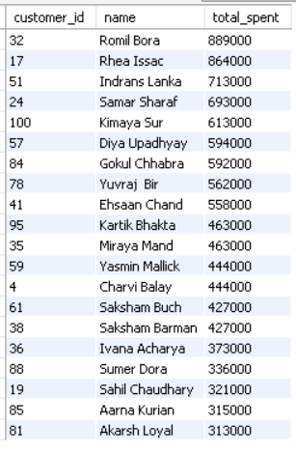
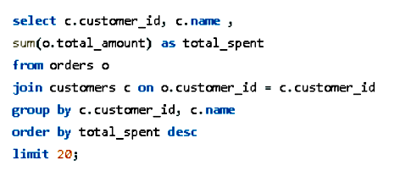
Top 20 customers by Total spending
SQL CODE-
LAUNCHING LOYALTY PROGRAMS, EXCLUSIVE DISCOUNTS OR GIVE EARLY ACCESS TO UPCOMING OFFERS TO RETAIN AND GROW THESE HIGH VALUE CUSTOMERS.

Slide 6
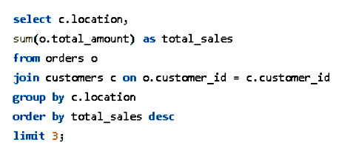
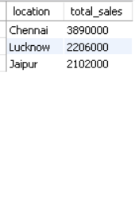
Top 3 locations with highest total sales
SQL CODE-
INCREASING AD SPEND AND LOCALIZED PROMOTIONS IN THESE 3 TOP-PERFORMING LOCATIONS

Slide 7
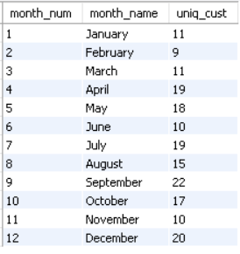
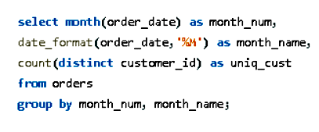
No. of Unique customers placing order each month.
SQL CODE-
IDENTIFYING SLOW MONTHS (FEB, JUNE, NOV IN THIS CASE) AND RUN TARGETED REACTIVATION CAMPAIGNS

Slide 8
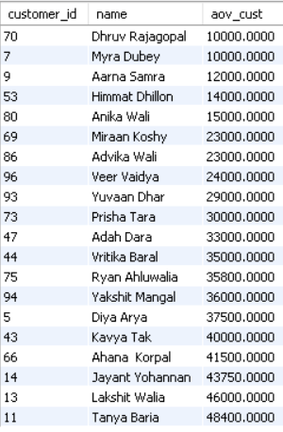
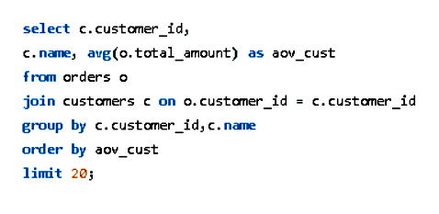
Average order value (AOV) per customer.
SQL CODE-
USING CROSS-SELLING AND UPSELLING TO RAISE AOV FOR PEOPLE WITH LOWER AOV

Slide 9
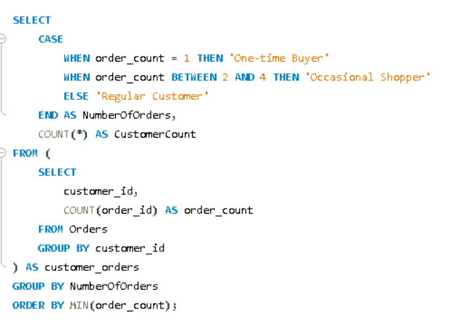

Customers with multiple purchases v/s one time purchasers
SQL CODE-
CREATING RETENTION CAMPAIGNS FOR THESE ONE TIME BUYERS TO REPEAT PURCHASES.

Slide 10
Product Analysis
By identifying best-sellers, underperformers, and high-margin items, we can optimize product mix, improve pricing strategies, and focus marketing efforts on the most profitable offerings while addressing slow-moving inventory.

Slide 11
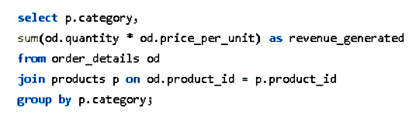
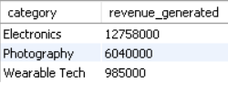
Category VS revenue GENERATED
SQL CODE-
FOCUSING MARKETING BUDGET AND STOCK ON THE HIGH REVENUE CREATING CATEGORIES
RUNNING LIMITED TIME OFFERS OR BUNDLE DEALS TO INCREASE SALES

Slide 12
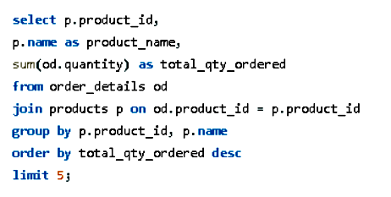
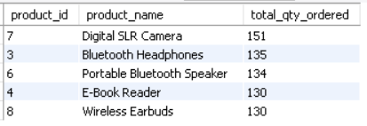
Top 5 products by quantity sold
SQL CODE-
ENSURING ADEQUATE STOCK AND FEATURE THESE TOP PRODUCTS PROMINENTLY IN MARKETING

Slide 13
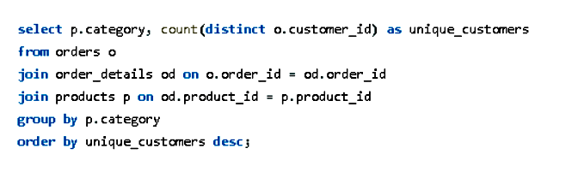

Category wise customer reach
SQL CODE-
PRIORITIZING PROMOTIONS AND BUNCLES CAN MAXIMISE IMPACT FOR CATEGORY WITH HIGHEST CUSTOMER REACH

Slide 14
Sales Optimization
This analysis explores sales trends within the year to identify peak periods and low-performing months. Understanding when and how customers buy enables us to time promotions effectively, boost revenue in slow months, and capitalize on high-demand periods through targeted campaigns and improved resource allocation.

Slide 15
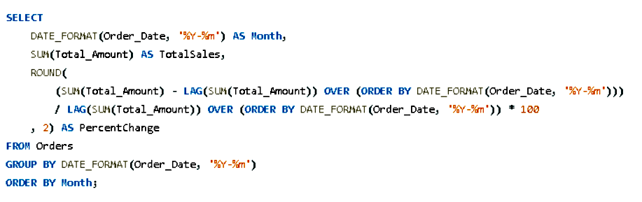
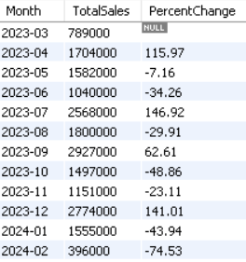
Total sale for each month
SQL CODE-
-IDENTIFYING PEAK MONTHS AND PLANNING CAMPAIGNS BEFORE THESE PERIODS
-REPLICATE SUCCESSFUL CAMPAIGNS FROM BEST MONTH IN THE NEXT YEAR
-ADDRESS LOW MONTHS WITH DISCOUNTS, INFLUENCER COLLABS, OR ADS

Slide 16
Conclusion
By leveraging SQL-driven insights, the company can:
Strengthen customer loyalty and retention.
Maximize sales in top-performing locations and product categories.
Smooth out seasonal dips through proactive campaigns.
Align inventory levels with actual demand patterns.
Implementing these strategies will enable data-driven decision-making that supports sustained business growth.

